Slide 1
MACHINE LEARNING
ACCURACY METRICS

Slide 2
CONFUSION MATRIX:
A much better way to evaluate the performance of a classifier is to look at the confusion matrix.
Confusion matrix is used to compare predicted and actual values
The general idea is to count the number of times instances of class A are classified as class B.
For example, to know the number of times the classifier confused images of 5s with 3s, you would look in the 5th row and 3rd column of the confusion matrix.

Slide 3
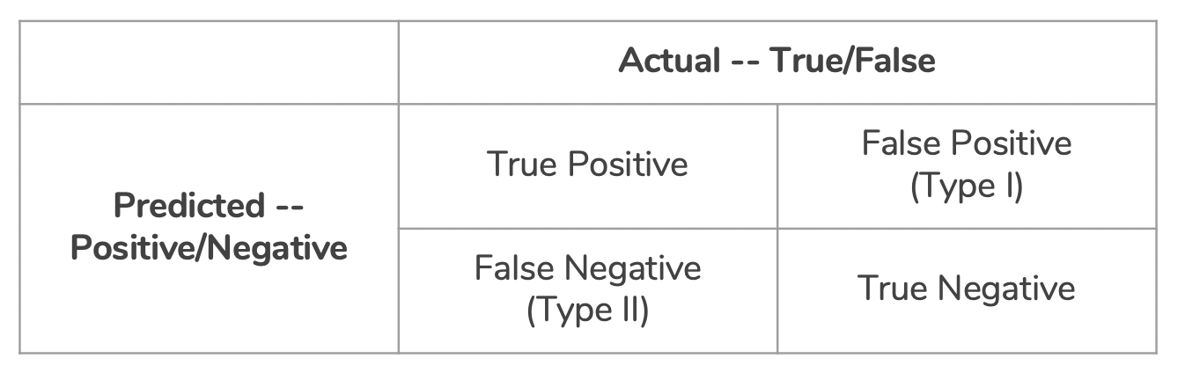
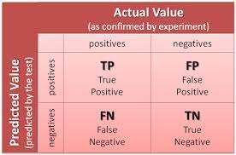

Slide 4
True Positive: Actual Positive and Predicted as Positive
True Negative: Actual Negative and Predicted as Negative
False Positive(Type I Error): Actual Negative but predicted as Positive
False Negative(Type II Error): Actual Positive but predicted as Negative

Slide 5
true positives (TP): These are cases in which we predicted yes (they have the disease), and they do have the disease.
true negatives (TN): We predicted no, and they don't have the disease.
false positives (FP): We predicted yes, but they don't actually have the disease. (Also known as a "Type I error.")
false negatives (FN): We predicted no, but they actually do have the disease. (Also known as a "Type II error.")

Slide 6
Type 1 error: Predicted value is positive, but it is false.
Type 2 error: Predicted value is negative, but it is positive.
A good model is one which has high TP and TN rates, while low FP and FN rates.

Slide 7
Accuracy = (TP+TN) / Total
Error Rate= (1 - accuracy) or Error Rate = (FP+FN)/ Total
Precision:
Precision = (TP) / (TP+FP)
TP is the number of true positives, and FP is the number of false positives. A trivial way to have perfect precision is to make one single positive prediction and ensure it is correct (precision = 1/1 = 100%). This would not be very useful since the classifier would ignore all but one positive instance.
Recall:
recall = (TP) / (TP+FN)

Slide 8
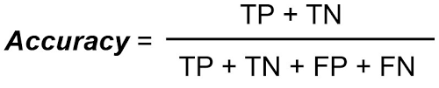
Accuracy
Overall, how often is the classifier correct?
Accuracy should be high as possible.

Slide 9
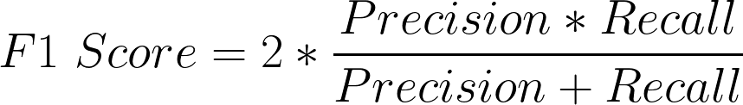
F1 Score:
It is difficult to compare two models with low precision and high recall or vice versa. So to make them comparable, we use F- score. F score helps to measure recall and precision at the same time. It uses harmonic mean in place of Arithmetic Mean by pushing the extreme values more.

